Slide 1




Department of Public Health, Environmental Health
Swati Bhatt, Manager
Specialized Surveillance and Enforcement
Department of Public Health

Slide 2
STATE’S REGULATORY FRAMEWORK
Year | Regulation | Description
2015 | Medical Cannabis Regulation and Safety Act (MCRSA) | Licensing and regulatory framework for medical cannabis activities
2016 | Proposition 64, the Adult Use of Marijuana Act (AUMA) | State licensing system for nonmedical commercial cannabis activities
2017 | Medicinal and Adult-Use Cannabis Regulation and Safety Act (MAUCRSA) | Consolidated MCRSA and AUMA to create one licensing structure within a single regulatory framework governing both commercial medicinal and adult-use cannabis activities, with some limited exceptions
2017 | Emergency Regulations for both medicinal and adult-use commercial cannabis businesses. | California Dept. of Food and Agriculture - Cultivation California Dept. of Public Health - Manufacturing Bureau of Cannabis Control – Distribution, Retail, Testing, Microbusiness
July 13, 2018 | Proposed Permanent Regulations for both medicinal and adult-use commercial cannabis businesses | Similar to the emergency regulations, but contain some changes and clarifications to all three regulatory agencies (CDFA, CDPH, BCC) 1

Slide 3
COMMERCIAL CANNABIS ACTIVITIES
Cannabis Facility Type | General Activities
Cultivation | Grow, trim, dry, cure, grade, package and label of cannabis including live plants and seeds
Manufacturing | Extraction, infusion, packaging and labeling of cannabis and cannabis products
Distribution | Storage services, package, re-package, label, re-label cannabis including pre- rolls; transport between permitted cannabis businesses; arrange for laboratory testing; conduct quality assurance
Retail | Sell cannabis including live plants and seeds, and cannabis products to customers; deliver products to customers

Slide 4
HEALTH AND SAFETY CONCERNS…
General sanitation/vermin proofed
Potable water supply protection/approved water source
Products safety
  approved source, storage, quality testing, packaging, labeling, THC concentration, etc.
Employee health, hygiene and knowledge
Cannabis product recalls

Slide 5
CONCERNS ASSOCIATED WITH EACH FACILITY TYPE
Cannabis Facility Type | Concerns
Cultivation | General sanitation, odor management, waste management, cross connection prevention of potable water supply
Manufacturing | Products and ingredients are from an approved source, extraction methods are approved by the Local Fire Department
Distribution | Storage requirements, batch sampling conducted by a California Certified Laboratory, Certificate of Analysis (COA), product labeling requirements
Retail | Only pre-packaged are available for sale, product labeling requirements, products are from an approved source, resale of contaminated/adulterated/returned items

Slide 6
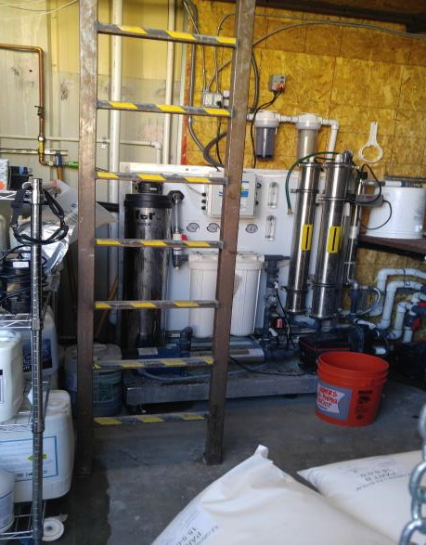
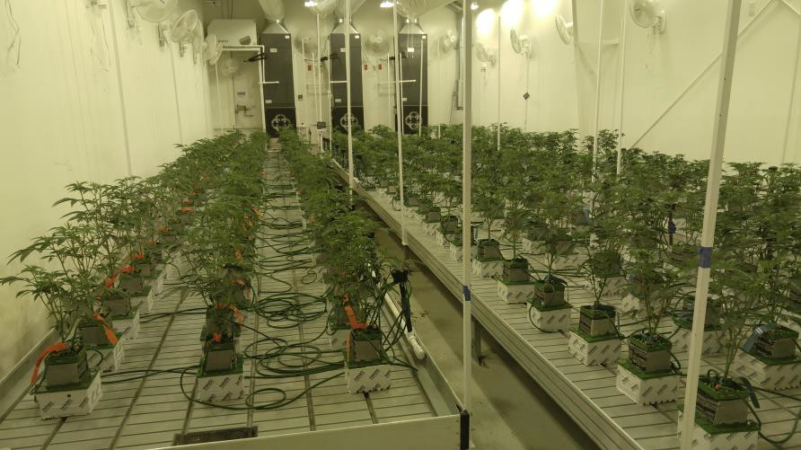
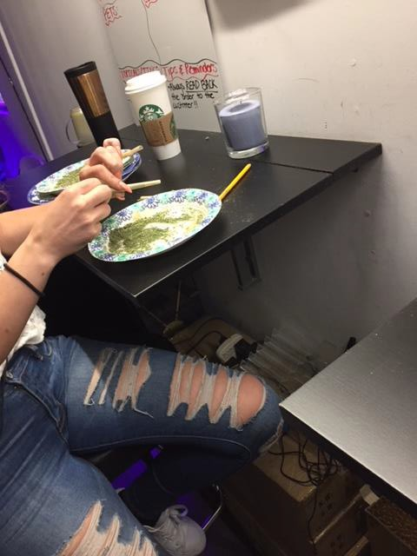
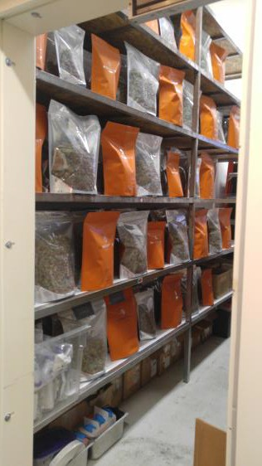
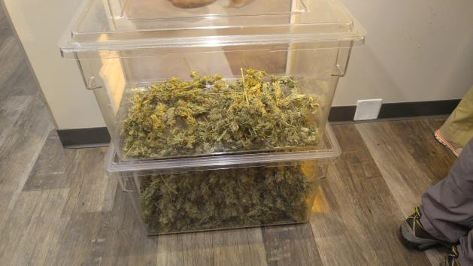
CANNABIS CULTIVATION FACILITY
5

Slide 7
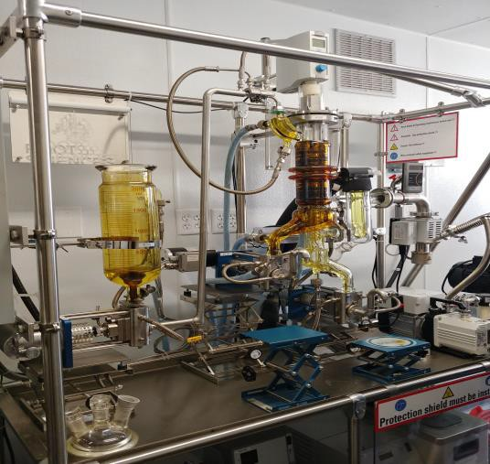
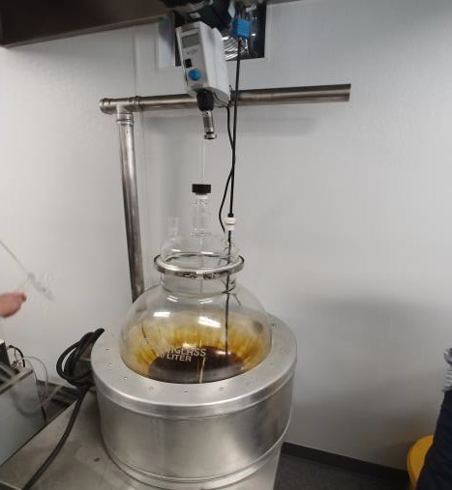
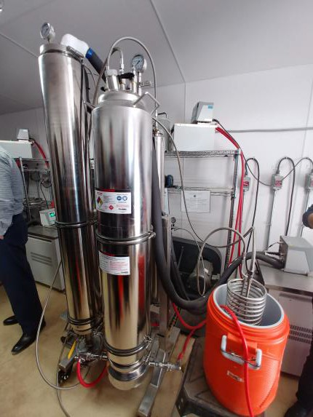
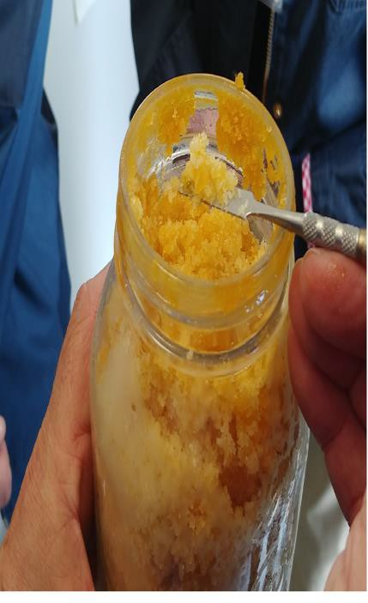
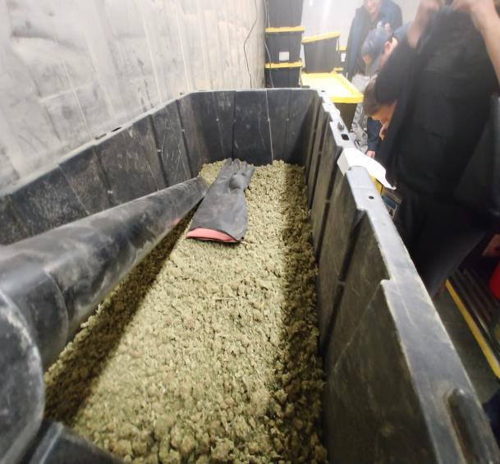
CANNABIS MANUFACTURING FACILITY

Slide 8
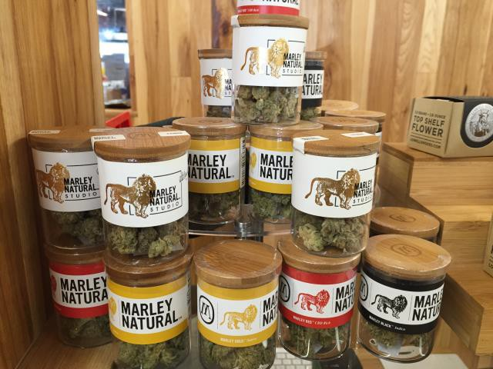
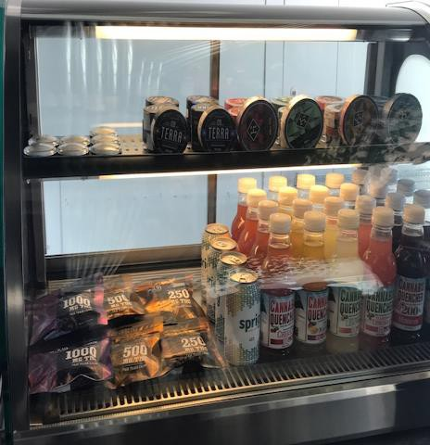
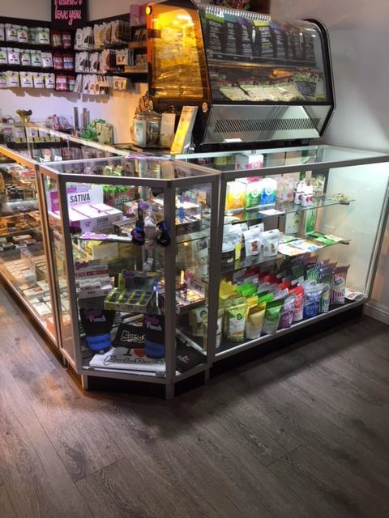
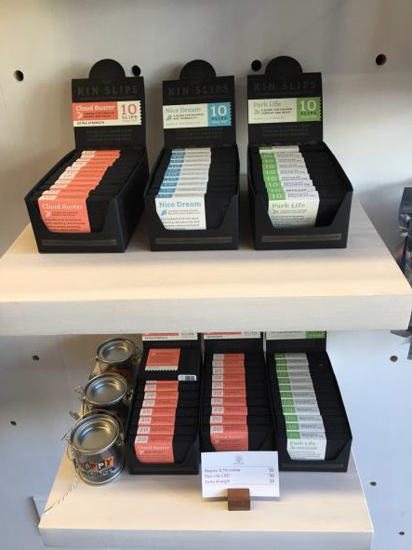
CANNABIS RETAIL FACILITY

Slide 9


UNAPPROVED
METHOD/EDIBLES/LABELING

Slide 10
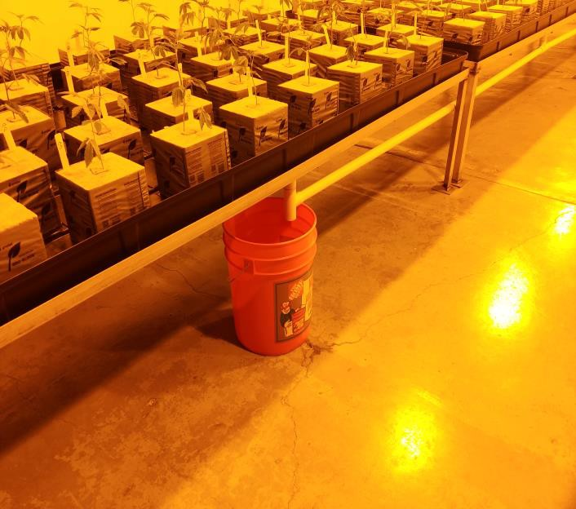
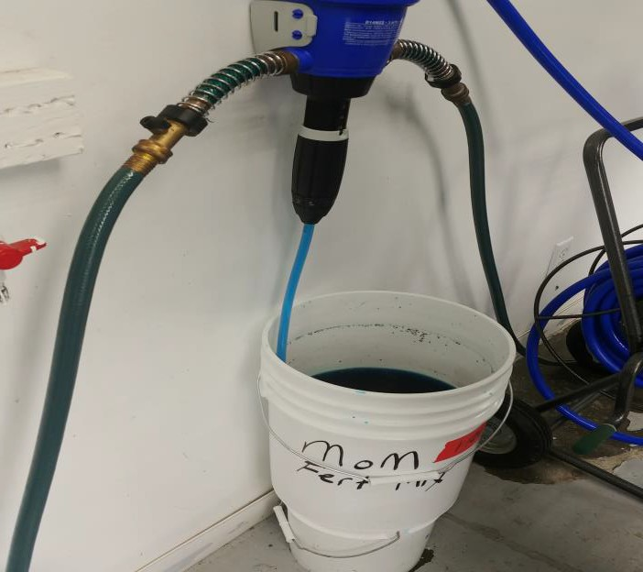
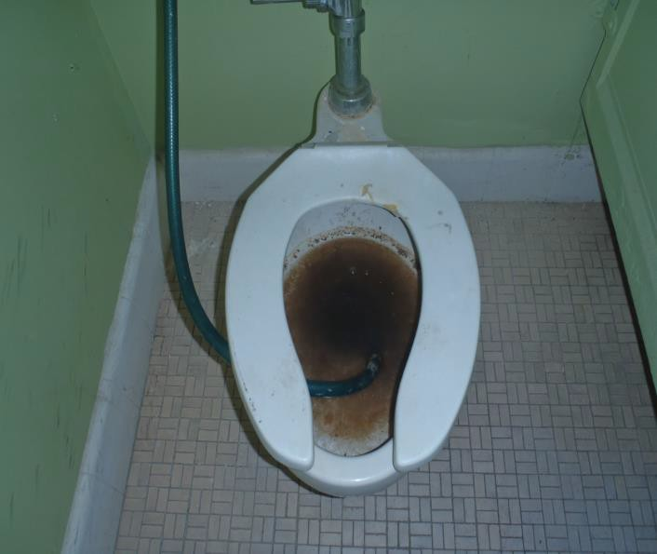


Slide 11
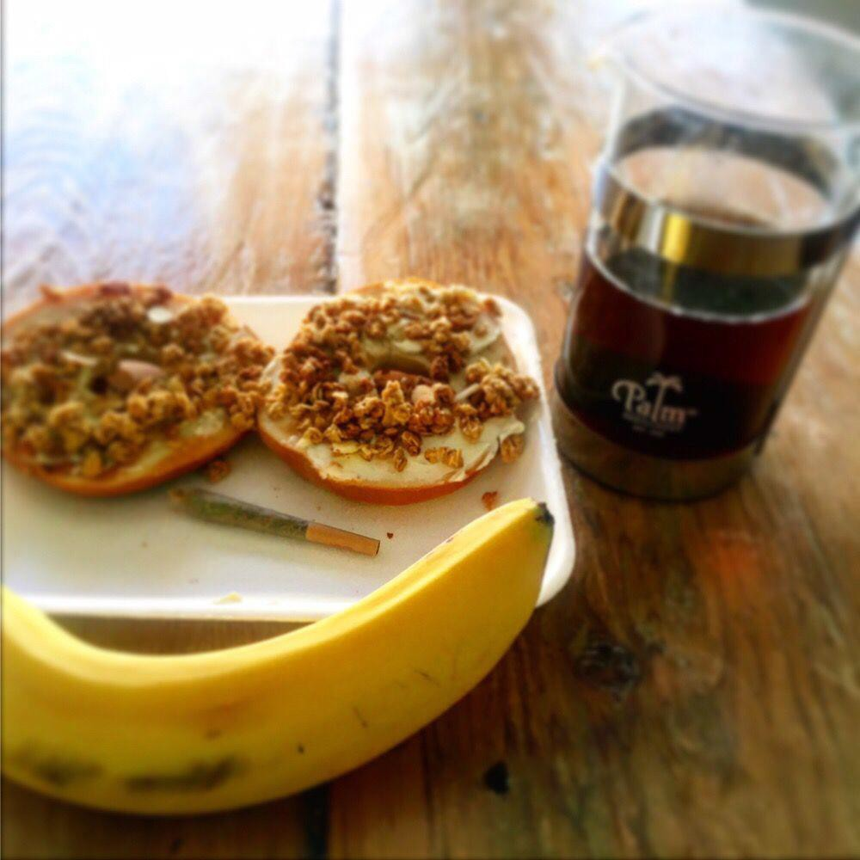

10

Slide 12
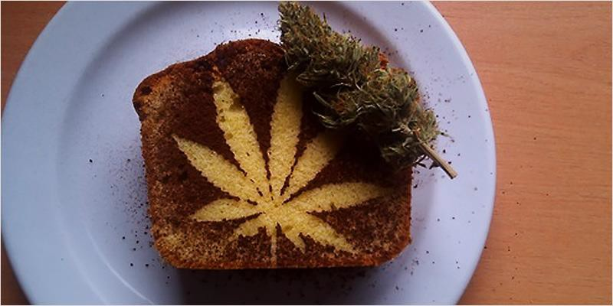
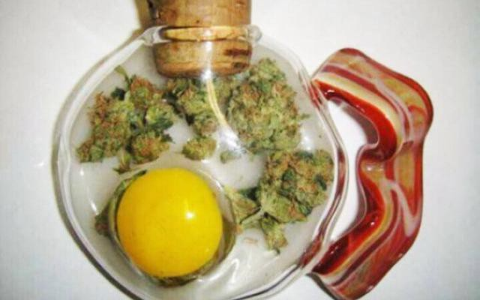
11

Slide 13
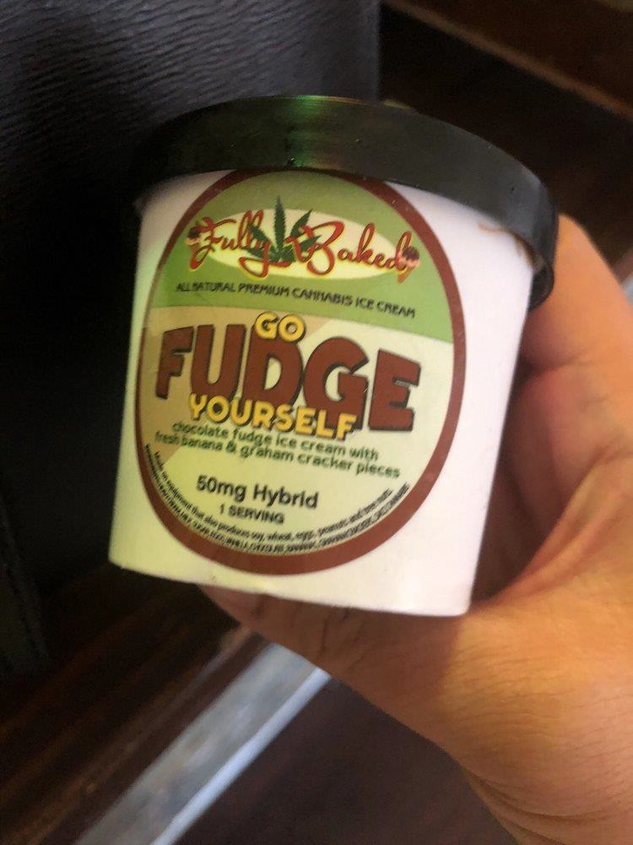
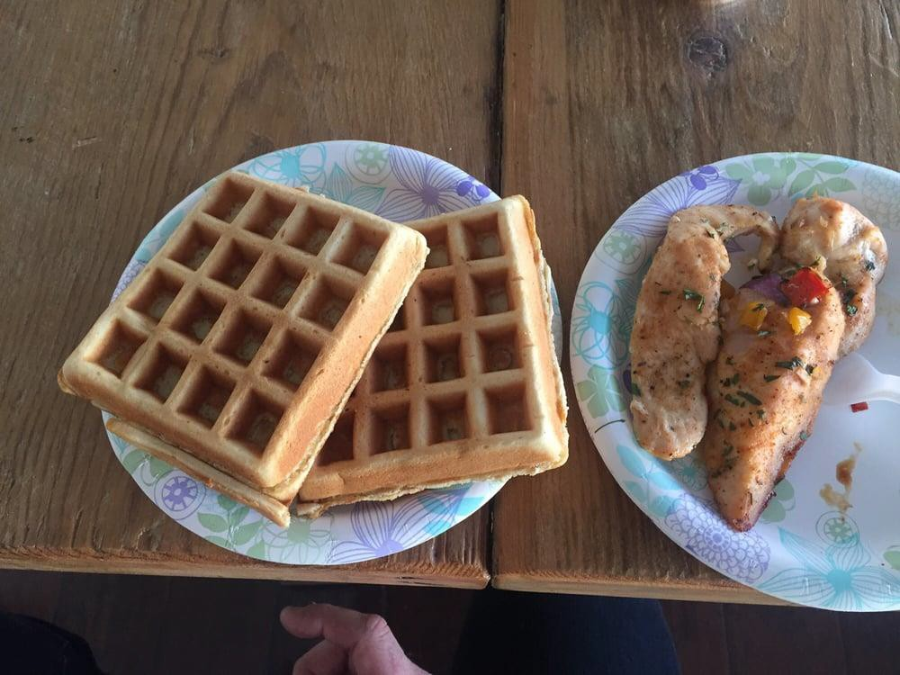
12

Slide 14
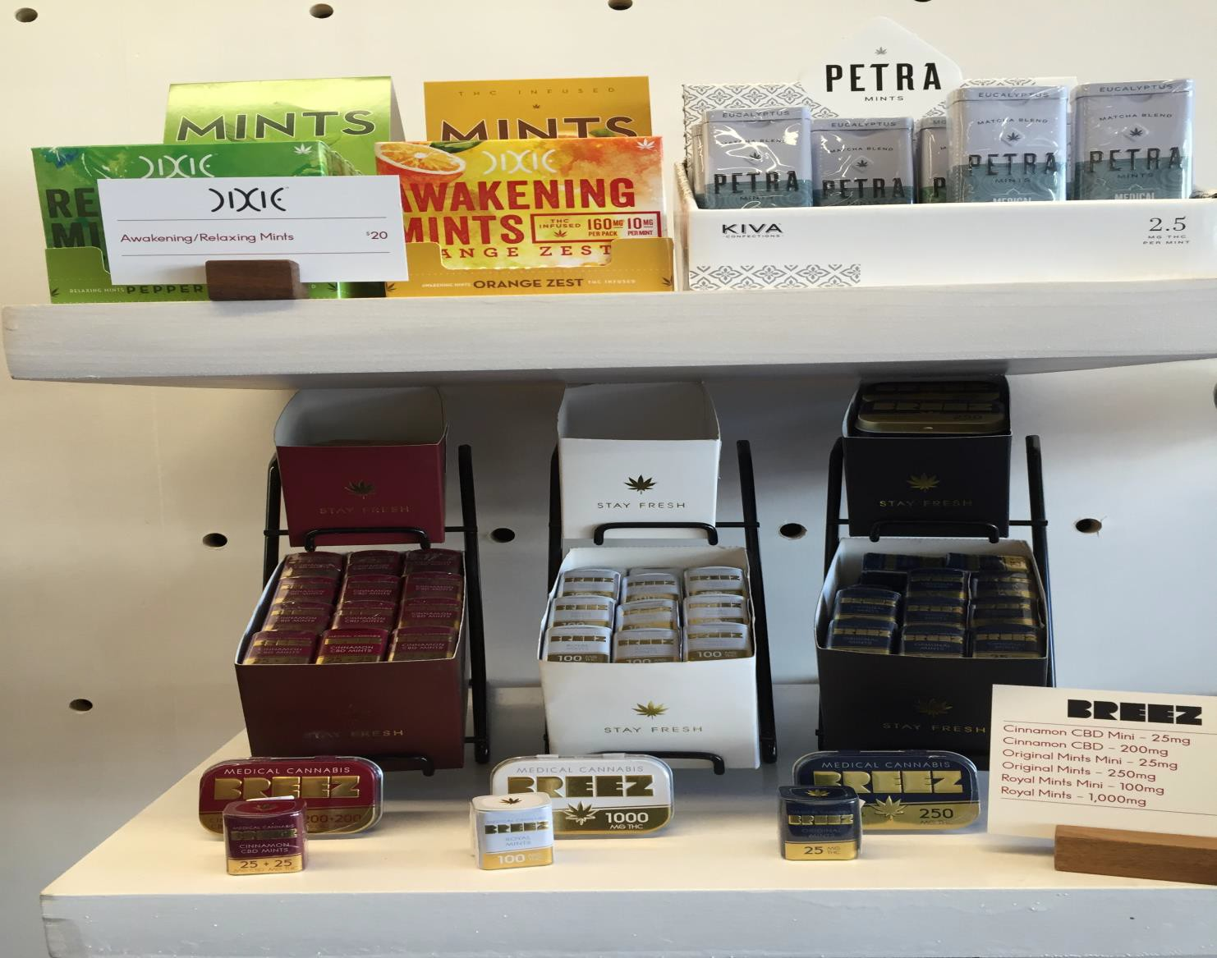
13

Slide 15
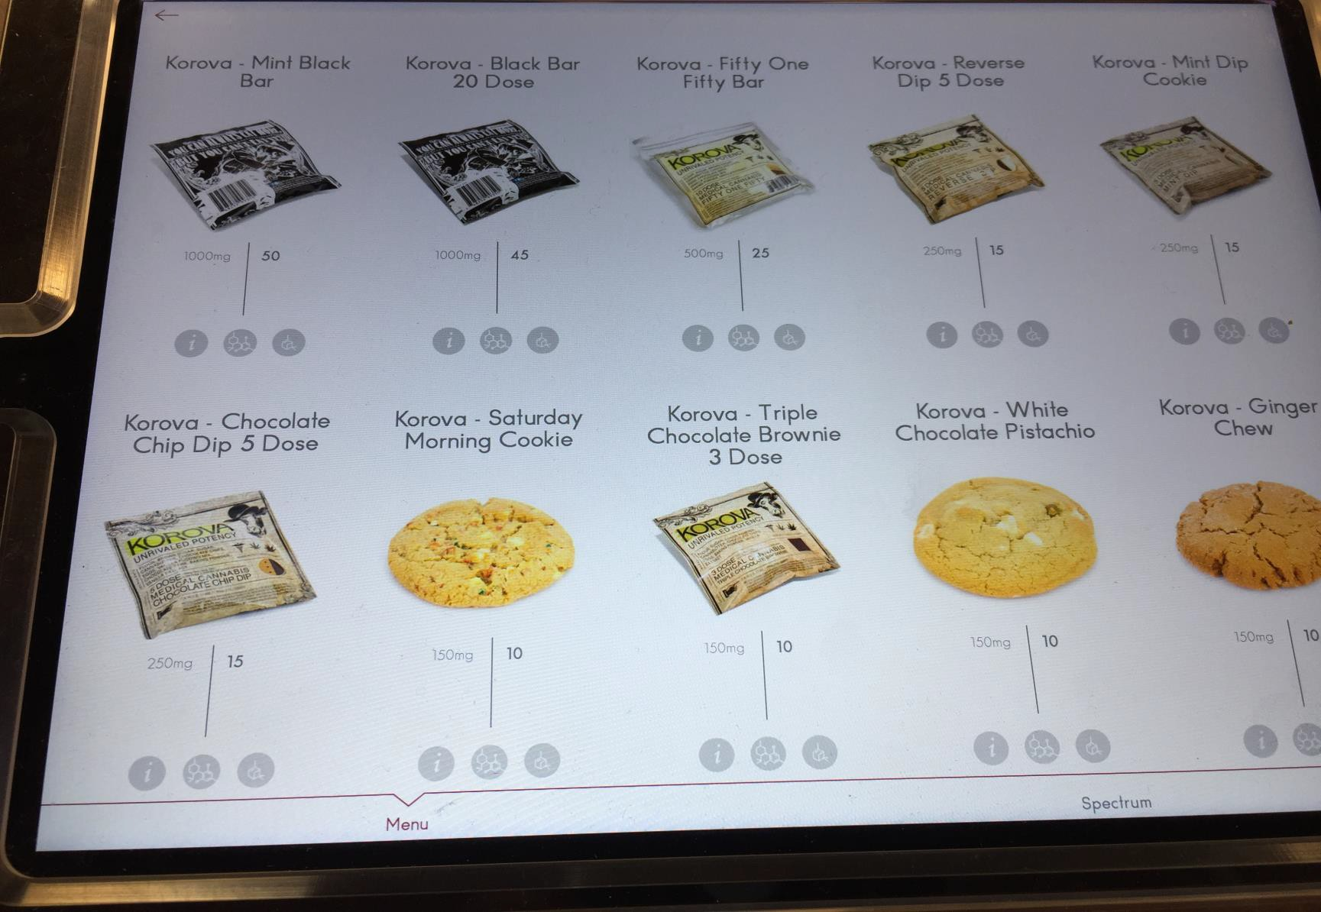
14

Slide 16
COUNTY INFORMATION
Cannabis Compliance and Enforcement Program Phone: 626-430-5635
Email: ccep@ph.lacounty.gov
Office of Cannabis Management (OCM) Email: cannabis@lacounty.gov Website: www.cannabis.lacounty.gov
15

